Slide 1
Lecture 6
How does compilation and interpretation really work?
EECS-214

Slide 2
Why study programming languages?
You may want to implement a scripting language or macro language for an application you’re working on
  Word, Excel, Web browsers, etc.
You may be working on a problem for which typical programming paradigms are inappropriate
  Make a new paradigm!
  Design your own language
  Make a simple interpreter for it
You’ll be making a simple interpreter for assignment 2

Slide 3

Machine language
Computer hardware is designed to do
  A very limited set of operations
  Very fast
  Very cheaply
Basically simple operations on elements of a big array (memory)
  m[a] = m[b] op m[c]
  An instruction specifies a, b, c, and the operation
  Instruction essentially encoded as obscure integers

Slide 4
Machine language
Good hardware design
Bad human interface

Slide 5


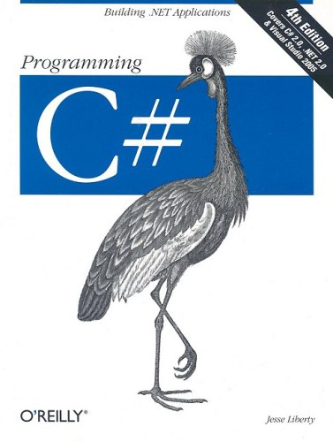
Higher-level languages
Let programmers work with higher-level entities
  Objects
  Fields
Using higher-level operations
  Methods
  Modules

Slide 6
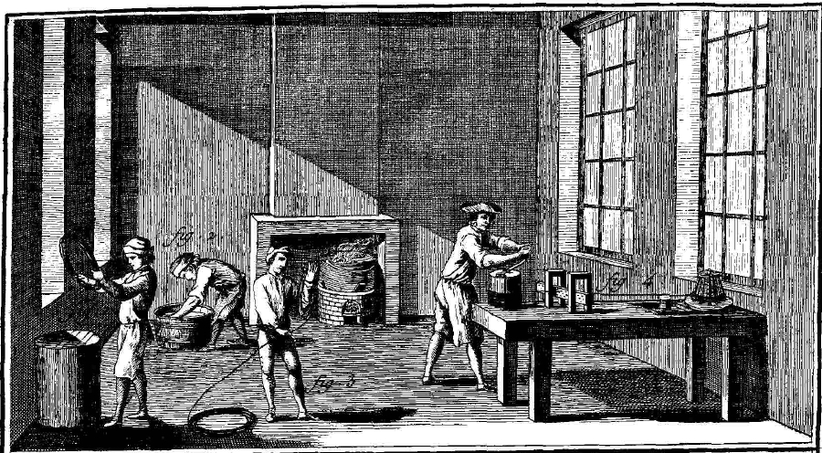
Division of labor
EEs and CEs build the fastest hardware they can to Run machine language
  Optimize hardware efficiency
CS people make the highest-level languages they can
  Optimize human efficiency
Compilers and interpreters make higher-level languages Run on machine-language platforms

Slide 7
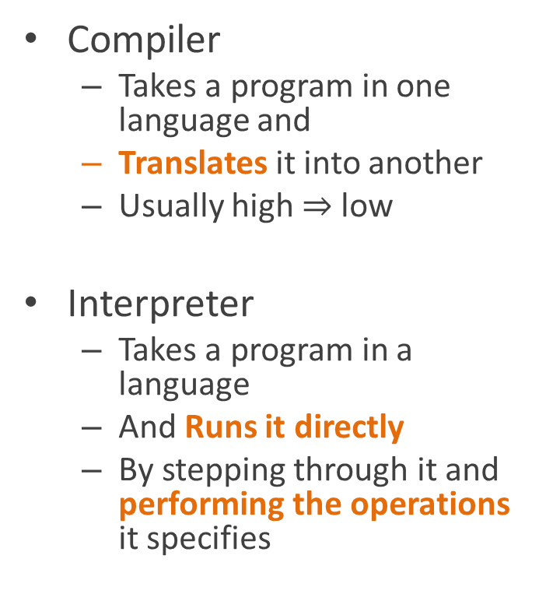
Compilers and interpreters
Compiler
  Takes a program in one language and
  Translates it into another
  Usually high $⇒$low
Interpreter
  Takes a program in a language
  And Runs it directly
  By stepping through it and performing the operations it specifies
target
language
compiler
source
language
interpreter
program output

Slide 8
Anatomy of a programming language
Programming languages are specified by grammars
A grammar specifies how
  expressions (phrases)
  are broken up into subexpressions (subphrases)
Sentence ⇒ NP VP
NP ⇒ [Art] [Adj] Noun
VP ⇒ Verb NP
Art = { the, a, an, some, … }
Adj = { green, happy, big, … }
Noun = { plate, president, cat, capitalism, … }
Verb = { be, eat, Run, … }
A really lame grammar for English

Slide 9
Simplified grammar for Racket
Expression ⇒
ComplexExpression | SimpleExpression
ComplexExpression ⇒
‘(‘ Expressions … ‘)’
SimpleExpression ⇒
Number | String | Variable
(note: the | means “or”)

Slide 10
(Over) simplified grammar for C-like languages
Expression ⇒
Constant | Variable
| Expression Op Expression
| ‘(‘ Expression ‘)’
| Expression ‘.’ MemberName
| Expression ‘.’ MethodName ‘(‘ Expression, … ‘)’
Constant ⇒
Number | ‘true’ | ‘false” | ‘null’ | String
Op ⇒ ‘+’ | ‘-’ | ‘*’ | ‘=‘ | …

Slide 11
Syntax trees (aka parse trees)
(You knew trees had to be coming here somewhere, right?)
Represent the internal structure of an expression
  Its subexpressions
Tree structure (duh)
  Nodes labeled with type of expression
  Children are subexpressions
+
-
+
a
1
b
*
2
c
(a-1)+b+2*c

Slide 12
Parsing
Breaking expression into its constituent parts
  Creates parse tree from linear string of tokens
Software for parsing is called a parser
+
-
+
a
1
b
*
2
c
(a-1)+b+2*c

Slide 13
Parsing
Algorithms for parsing
  Extensively studied
  Outside the scope of this class
  Cool at a high level
  Very boring in the details
In practice, one usually uses a parser generator,
  Program that takes a grammar as input
  Produces a parser as output
+
-
+
a
1
b
*
2
c
(a-1)+b+2*c

Slide 14
Parsing
That’s all we’re going to say about parsing …
+
-
+
a
1
b
*
2
c
(a-1)+b+2*c

Slide 15
Compositional semantics
An expression’s meaning is
  Derived from
  The meanings of its parts
  In some systematic manner
+
1
*
2
3

Slide 16
Compositional semantics
Example
The value (meaning) of a sum expression
+
1
*
2
3

Slide 17
Compositional semantics
Example
The value (meaning) of a sum expression
Is the values of its subexpressions
+
1
6
1
*
2
3

Slide 18
Compositional semantics
Example
The value (meaning) of a sum expression
Is the values of its subexpressions
Added together
7
+
1
*
2
3

Slide 19
Syntax-directed interpretation
An interpreter works by following the structure of the syntax tree
Example
Arithmetic expressions: find the value of a parent node
  By finding the values of subtrees
  And using them as arguments to the function the parent node represents
+
1
*
2
3

Slide 20
Syntax-directed interpretation
Interpreter for arithmetic expressions
Run(STNode) {
leftValue = Run(STNode.leftChild)
rightValue = Run(STNode.rightChild)
return DoTheMath(leftValue, rightValue)
}
+
1
*
2
3
Assume this is some magic code that Runs the operator (+ or *)

Slide 21
Syntax-directed interpretation
Okay, in reality, we have to handle
the case where the node isn’t an operator
Run(STNode) {
if STNode is a constant
return the constant
else
leftValue = Run(STNode.leftChild)
rightValue = Run(STNode.rightChild)
return DoTheMath(leftValue, rightValue)
}
+
1
*
2
3

Slide 22
Syntax-directed interpretation
Run(+)
+
1
*
2
3

Slide 23
Syntax-directed interpretation
Run(+)
Run(1)
+
1
*
2
3

Slide 24
Syntax-directed interpretation
Run(+)
Run(1)
return 1
+
1
1
*
2
3

Slide 25
Syntax-directed interpretation
Run(+)
Run(1)
return 1
Run(*)
+
1
*
2
3

Slide 26
Syntax-directed interpretation
Run(+)
Run(1)
return 1
Run(*)
Run(2)
+
1
*
2
3

Slide 27
Syntax-directed interpretation
Run(+)
Run(1)
return 1
Run(*)
Run(2)
return 2
+
1
*
2
2
3

Slide 28
Syntax-directed interpretation
Run(+)
Run(1)
return 1
Run(*)
Run(2)
return 2
Run(3)
+
1
*
2
3

Slide 29
Syntax-directed interpretation
Run(+)
Run(1)
return 1
Run(*)
Run(2)
return 2
Run(3)
return 3
+
1
*
3
2
3

Slide 30
Syntax-directed interpretation
Run(+)
Run(1)
return 1
Run(*)
Run(2)
return 2
Run(3)
return 3
return 6
+
6
1
*
2
3

Slide 31
Syntax-directed interpretation
Run(+)
Run(1)
return 1
Run(*)
Run(2)
return 2
Run(3)
return 3
return 6
return 7
7
+
1
*
2
3

Slide 32
Syntax-directed interpretation
Look familiar?
Run(STNode) {
leftValue = Run(STNode.leftChild)
rightValue = Run(STNode.rightChild)
return DoTheMath(leftValue, rightValue)
}
+
1
*
2
3

Slide 33
Post-order traversal
This is just a depth-first walk
  In particular, a post-order walk
This is a super-simplified case
  Only arithmetic expressions
  Only binary trees
But the idea is much the same for more complicated cases
+
1
*
2
3

Slide 34
Handling variable references
That’s great!
But what do we do when we see a variable?
+
-
+
a
1
b
*
2
c

Slide 35
Environments
Name | Value
a | 5
b | -2
c | 4.2
+
-
+
a
1
b
*
Data structures that store the values of variables
We’ll implement these using dictionaries
2
c

Slide 36
Dictionaries
A.k.a. associative array, map, mapping
Data structure that holds associations between pairs of objects called keys and values
Simplified interface
(we’ll talk more about dictionaries later):
dict.Store(key, value)
  Adds key to dictionary with associated value
  We’ll assume that if the key is already present, this changes its value
dict.Lookup(key)
  Returns value associated with key in dict

Slide 37
Implementing dictionaries with association lists
The simplest possible implementation of dictionaries is as a linked list of key/value pairs
Each cell has three fields
  Key
  Value
  Link to next cell
a
5
b
-2
c
4.2

Slide 38
Implementing dictionaries with association lists
This isn’t a great representation because lookup requires linear time
  i.e. O(n)
Next week, we’ll look at structures that can do lookup in log time
  And after that, (near) constant time
a
5
b
-2
c
4.2

Slide 39
Handling variable references
Now all we have to do is
Add a rule for handling nodes that are variable references
Add a dictionary argument to the Run procedure that holds the current environment
+
-
+
a
1
b
*
2
c

Slide 40
Handling variable references
+
Run(STNode, dict) {
if STNode is a constant
return the constant
else if STNode is a variable
return dict.Lookup(STNode.variableName)
else
leftValue = Run(STNode.leftChild, dict)
rightValue = Run(STNode.rightChild, dict)
return DoTheMath(leftValue, rightValue)
}
-
+
a
1
b
*
2
c

Slide 41
Bleh! This is ugly!
+
Run(STNode, dict) {
if STNode is a constant
return the constant
else if STNode is a variable
return dict.Lookup(STNode.variableName)
else
leftValue = Run(STNode.leftChild, dict)
rightValue = Run(STNode.rightChild, dict)
return DoTheMath(leftValue, rightValue)
}
-
+
a
1
b
*
2
c

Slide 42
Inheritance to the rescue!
+
abstract class SyntaxTreeNode {
… other stuff …
abstract object Run(Dictionary d);
}
class Constant : SyntaxTreeNode {
… other stuff …
override Run(Dictionary d) {
return the value of the constant
}
}
class VariableReference : SyntaxTreeNode {
… other stuff …
override Run(Dictionary d) {
return look up variable name in d
}
}
-
+
a
1
b
*
2
c
class ArithmeticOperation : SyntaxTreeNode {
… other stuff …
override Run(Dictionary d) {
Call Run on the children to get
their values
Perform the math operation on the results
}
}

Slide 43
Compilation
Compilers are just like interpreters
  Depth-first traversal of the syntax tree
  Incrementally builds up the output by finding the output for subtrees
At least to a first approximation…

Slide 44
Compilation
The difference is that
  When an interpreter sees +, it outputs the sum
  When a compilers sees +, it outputs machine code to compute the sum

Slide 45
Stack machines
(you knew we had to get stacks in here too…)
Simple kind of machine code
  No longer popular for hardware implementation
  But still popular as an intermediate code for “bytecoded” languages like Java, C#, Python
Stores intermediate results on a stack
Basic operations
Push: pushes a constant on the stack
Arithmetic (e.g. +)
  Pops arguments from stack
  Computes result
  Pushes result on stack
Other stuff
  Load/store for variables
  Procedure call
  Other good stuff
  But we don’t have time to talk about these

Slide 46
Computing 1+2*3 on a stack machine
Program:
Push 1
Push 2
Push 3
*
+
Stack

Slide 47
Computing 1+2*3 on a stack machine
Program:
Push 1
Push 2
Push 3
*
+
1
Stack

Slide 48
Computing 1+2*3 on a stack machine
Program:
Push 1
Push 2
Push 3
*
+
2
1
Stack

Slide 49
Computing 1+2*3 on a stack machine
Program:
Push 1
Push 2
Push 3
*
+
3
2
1
Stack

Slide 50
Computing 1+2*3 on a stack machine
Program:
Push 1
Push 2
Push 3
*
+
6
1
Stack

Slide 51
Computing 1+2*3 on a stack machine
Program:
Push 1
Push 2
Push 3
*
+
7
Stack

Slide 52
Syntax-directed compilation
Just change the code for Run so that
Instead of performing an operation
It outputs code that can perform it
Compile(STNode) {
if STNode is a constant
add “push constant” to the code
else
Compile(STNode.leftChild)
Compile(STNode.rightChild)
add math operation to the compiled code
}
+
1
*
2
3

Slide 53
Syntax-directed compilation
Generated code:
Compile(+)
+
1
*
2
3

Slide 54
Syntax-directed compilation
Generated code:
Compile(+)
Compile(1)
+
1
*
2
3

Slide 55
Syntax-directed compilation
Generated code:
Push 1
Compile(+)
Compile(1)
Emit “push 1”
+
1
*
2
3

Slide 56
Syntax-directed compilation
Generated code:
Push 1
Compile(+)
Compile(1)
Emit “push 1”
Compile(*)
+
1
*
2
3

Slide 57
Syntax-directed compilation
Generated code:
Push 1
Compile(+)
Compile(1)
Emit “push 1”
Compile(*)
Compile(2)
+
1
*
2
3

Slide 58
Syntax-directed compilation
Generated code:
Push 1 push 2
Compile(+)
Compile(1)
Emit “push 1”
Compile(*)
Compile(2)
Emit “push 2”
+
1
*
2
3

Slide 59
Syntax-directed compilation
Generated code:
Push 1 push 2
Compile(+)
Compile(1)
Emit “push 1”
Compile(*)
Compile(2)
Emit “push 2”
Compile(3)
+
1
*
2
3

Slide 60
Syntax-directed compilation
Generated code:
Push 1 push 2 push 3
Compile(+)
Compile(1)
Emit “push 1”
Compile(*)
Compile(2)
Emit “push 2”
Compile(3)
Emit “push 3”
+
1
*
2
3

Slide 61
Syntax-directed compilation
Generated code:
Push 1 push 2 push 3 *
Compile(+)
Compile(1)
Emit “push 1”
Compile(*)
Compile(2)
Emit “push 2”
Compile(3)
Emit “push 3”
Emit *
+
1
*
2
3

Slide 62
Syntax-directed compilation
Generated code:
Push 1 push 2 push 3 * +
Compile(+)
Compile(1)
Emit “push 1”
Compile(*)
Compile(2)
Emit “push 2”
Compile(3)
Emit “push 3”
Emit *
Emit +
+
1
*
2
3

Slide 63
trees rock!

Slide 64
Assignment 2
Out Monday 4/22
  Due following Monday 4/29
Implement interpreter for simple arithmetic expression
We’ve implemented most of it, but you should fill in the parts we haven’t done yet
  Create ListDictionary class for representing environments
  Fill in the SyntaxTreeNode classes we haven’t implemented already
  Write unit tests for the parts you write

Slide 65
The SyntaxTreeNode class
Abstract class for parse tree nodes (aka syntax tree nodes)
Defines an abstract Run() method
  Takes an Dictionary as an argument
+
1
*
2
3

Slide 66
The SyntaxTreeNode subclasses
Constant
  A tree node representing a constant (1, false, “fred”, etc.)
VariableReference
  Gives the current value of a variable
VariableAssignment
  Changes value of said variable
ArithmeticOperation
  Represents a +, -, *, or / expression
+
1
*
2
3

Slide 67
The SyntaxTreeNode subclasses
Run(environment) returns
For a Constant
  Whatever the constant is
For a VariableReference
  Looks up variable by name
  in dictionary and returns its value
For a VariableAssignment
  Updates value of variable in dictionary
  And returns value
For an ArithmeticOperation
  Get the values of the children
  Look at the name of the operation (it will be a string, like “+” or “*”)
  Perform that operation on the values of the children and return the result
+
1
*
2
3

Slide 68
Parsing
We’ve taken care of parsing for you
  You need only worry about it
  Expressions will already be built for your from code in the level files
If you want to learn about it, it’s in the Parsing folder
+
1
*
2
3

Slide 69
any questions?

